Slide 1
Problem: coco “perfect annotation” is not perfect
I checked databases including: PASCAL VOC (2012, 2007), Google open image (v6, v4, v2), ImageNet Large Scale Visual Recognition Challenge (ILSVRC)
Google open image shows a better annotation while the others are similar to coco. However, open images often, but not always, only label one person for one image even though there are groups of people
I think we can assume what coco provides as ‘perfect’

Slide 2
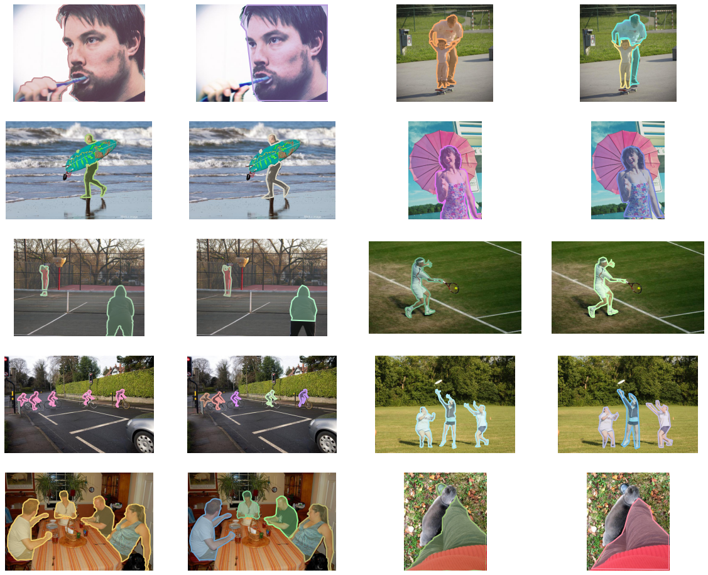

Slide 3
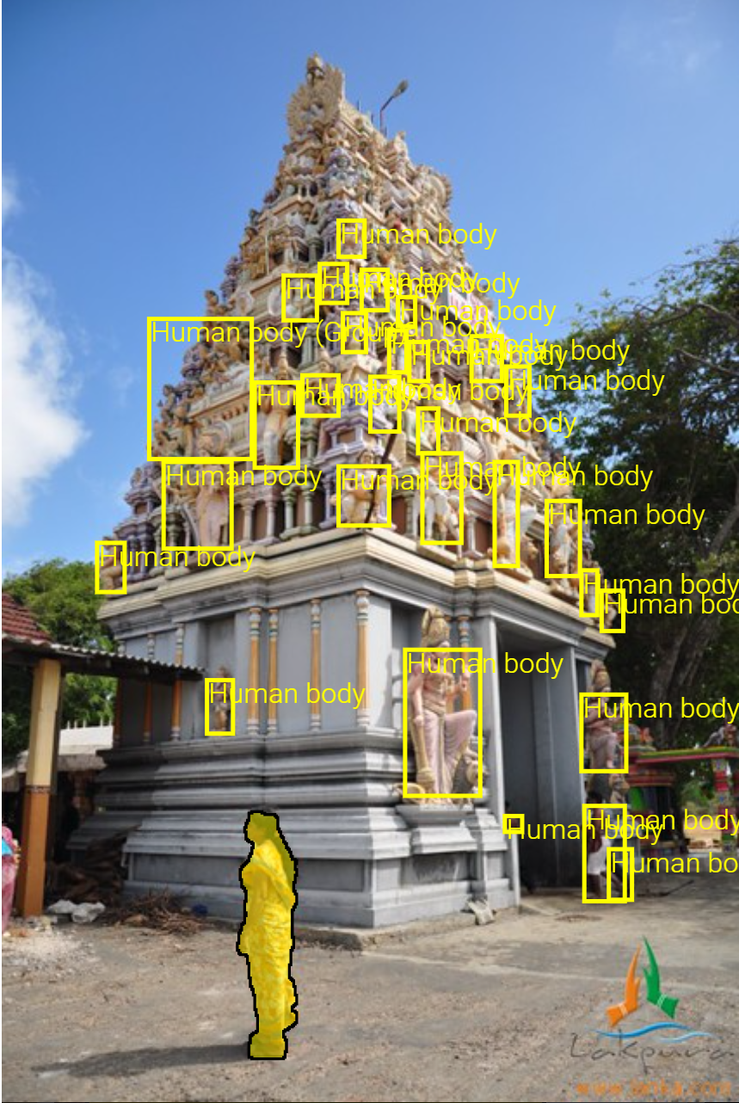
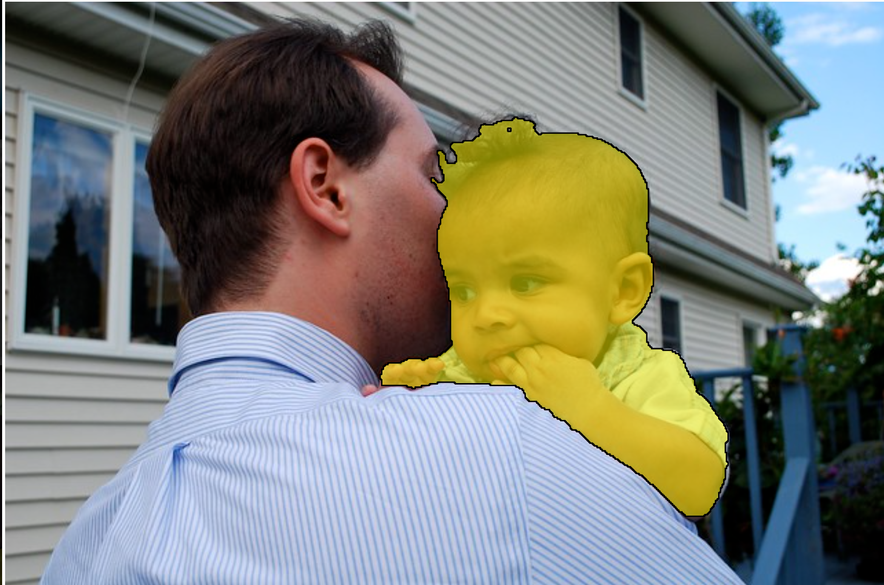

Slide 4
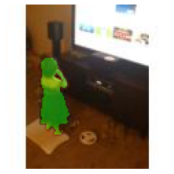


Slide 5
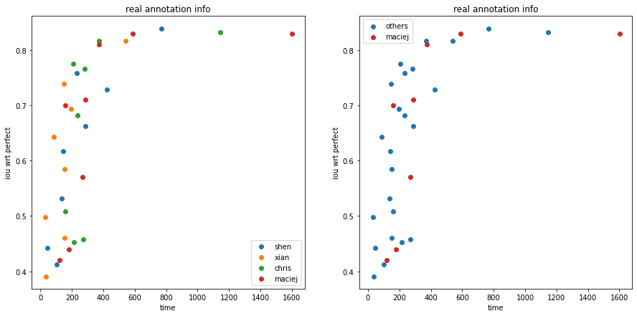
Annotation time vs accuracy compared to coco perfect annotation

Slide 6
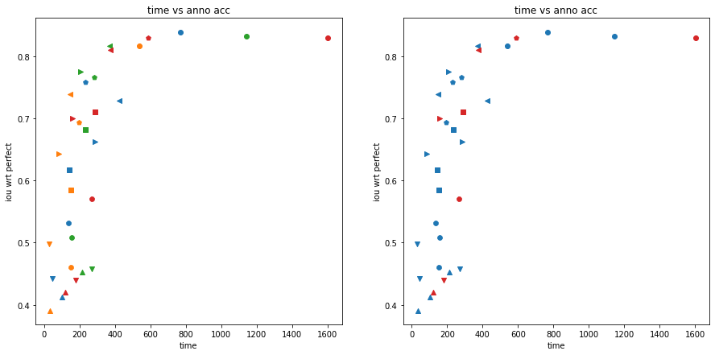

Slide 7
 | perfect | individual_bounding_box | multiple_bounding_box | approx_contour | less_precise_contour | triangle | pentagon | 8_to_12_edges | one_point | scribble
shen_time | 767.8 | 45.3 | 101.8 | 424.1 | 285.7 | 136.5 | 143.7 | 230.7 | 28.3 | 38.2
xian_time | 539.3 | 30.1 | 34.8 | 147 | 84.8 | 152.7 | 152.6 | 194.5 | 22.5 | 26.5
chris_time | 1143.7 | 271.2 | 214.3 | 371 | 207.2 | 157.6 | 233.8 | 281.4 | 56.1 | 98.3
maciej_time | 1601.5 | 178.6 | 120.3 | 373.7 | 158.6 | 268.3 | 287.6 | 587.8 | 44.4 | 106.2
shen_acc | 0.84 | 0.44 | 0.41 | 0.73 | 0.66 | 0.53 | 0.62 | 0.76
xian_acc | 0.82 | 0.50 | 0.39 | 0.74 | 0.64 | 0.46 | 0.58 | 0.69
chris_acc | 0.83 | 0.46 | 0.45 | 0.82 | 0.78 | 0.51 | 0.68 | 0.77
maciej_acc | 0.83 | 0.44 | 0.42 | 0.81 | 0.7 | 0.57 | 0.71 | 0.83

Slide 8
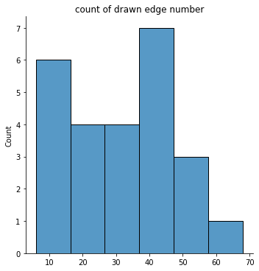
Polygon – no limit
Average 32 edges per target; IoU 0.83 compared
to coco perfect, same IoU as ‘perfect’ method
Hard to generate similar mask
IoU compared to generated mask:
Other IoU between generated method and annotated images
Poly-12 | Poly-15 | Poly-16 | Poly-17 | Poly-32 | Filter-3 | Filter-5
0.63 | 0.65 | 0.63 | 0.61 | 0.54 | 0.70 | 0.66
0.83 | 0.79 | 0.83 | 0.82 | 0.78 | 0.91 | 0.93 | 0.85 | 0.80 | 0.82 | 0.77

Slide 9
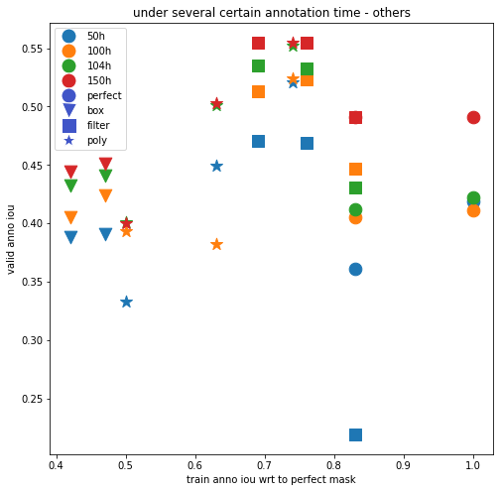
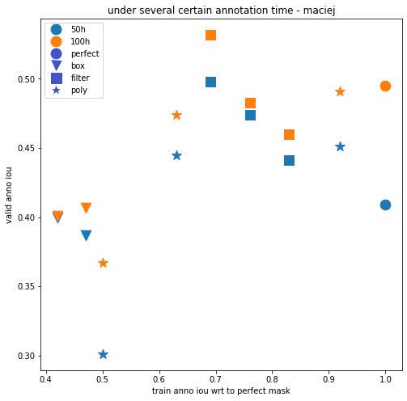

Slide 10
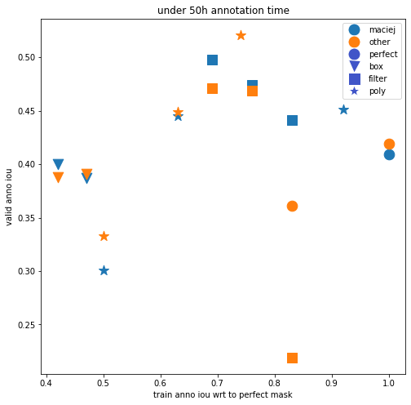
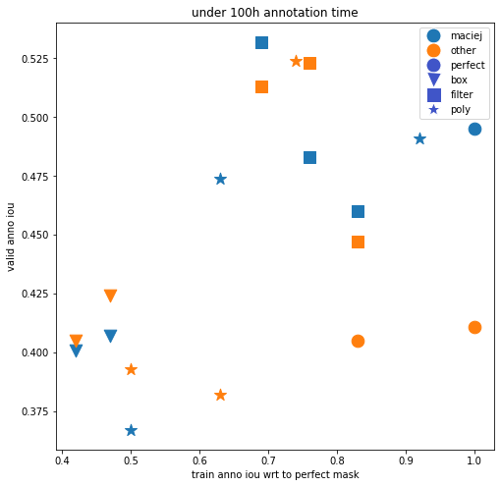

Slide 11
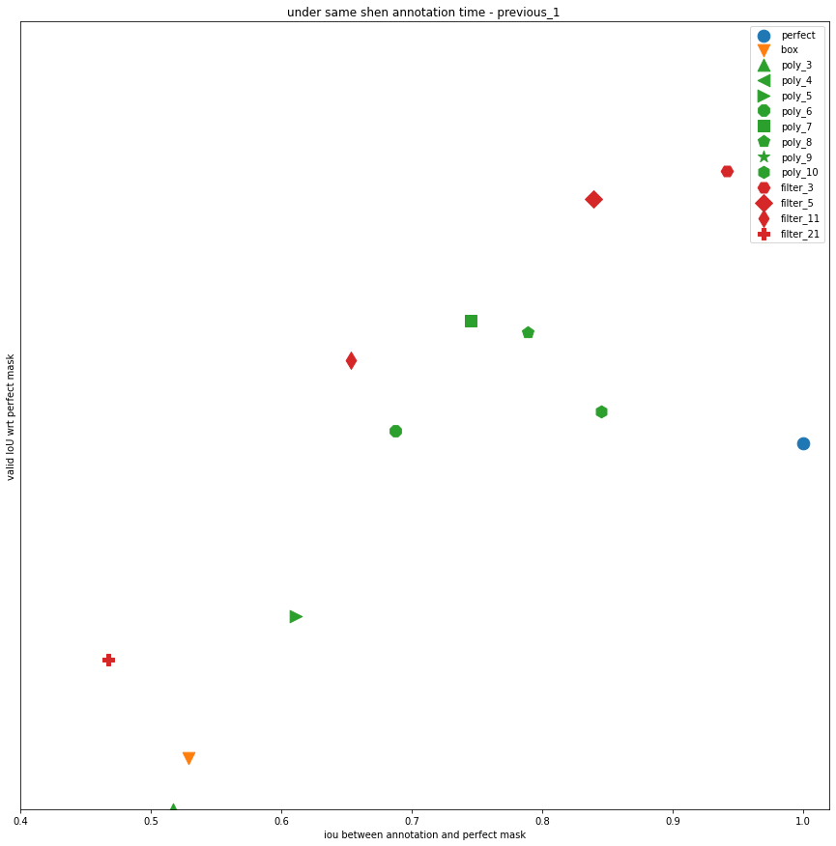

Slide 12
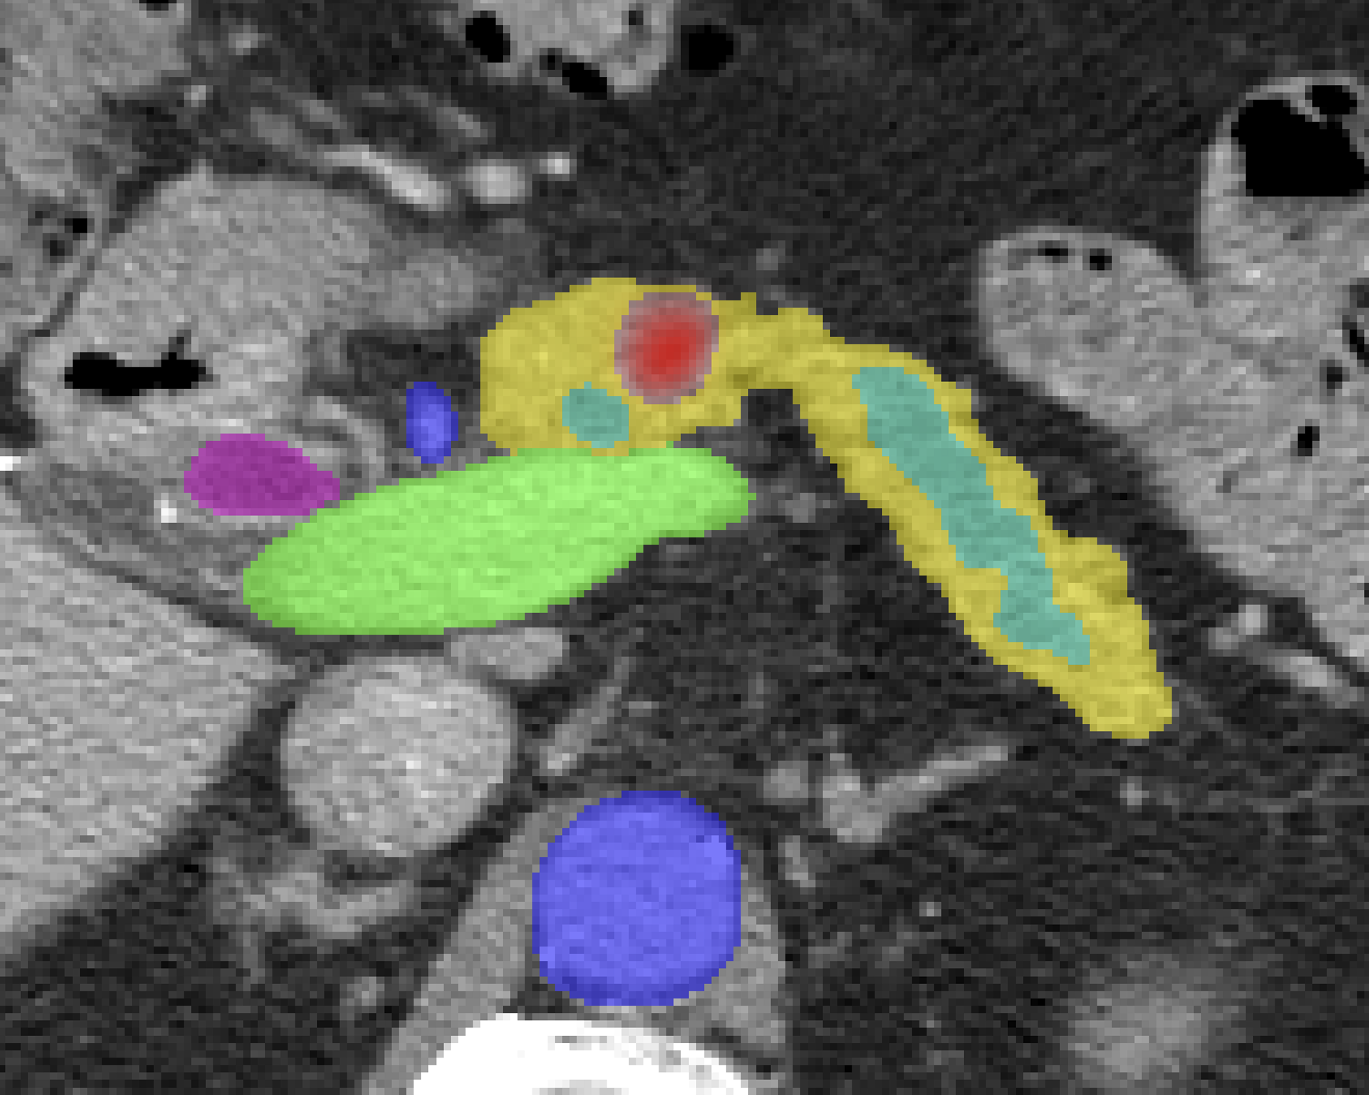
About medical images
I’m trying on a dataset called ‘Medical Segmentation Decathlon’. It contain segmentation for liver, brain, Pancreas, lung tumor; hippocampus. Each category has around 300 hundreds images. And I could find related paper that applies modified Unet to perform segmentation
Still working on get correct annotation

Slide 16
Method 1: randomly enlarge perfect mask by 15% wrt center of bounding box
Method 2: randomly enlarge perfect mask by 15% and shift 0-15 pixels for all four direction
Method 3: enlarge by 15%, and shift 0-30 pixels
IoU between perfect and directly generated bounding box is 0.53
IoU between perfect and #2/#3 is 0.47/0.42 (average for 10k images 5 times)
IoU between our annotation and #2/#3 is 0.88 and 0.86
 | perfect | perfect2 | perfect3 | individual_bounding_box | multiple_bounding_box | approx_contour | less_precise_contour | triangle | pentagon | 8_to_12_edges2
Train anno IoU wrt perfect | 0.83 | 0.83 | 0.83 | 0.47 | 0.42 | 0.76 | 0.69 | 0.5 | 0.63 | 0.74
generated | Filter_5 | #1 | perfect | #2 | #3 | Filter_7 | Filter_9 | Poly_3 | Poly_5 | Poly_8
Ave_time | 816.93 | 816.93 | 816.93 | 115.53 | 116.97 | 314.03 | 192.57 | 148.93 | 176.7 | 235.53
50h | 2203 | 2203 | 2203 | 15580 | 15389 | 5732 | 9347 | 12086 | 10187 | 7642
iou50 | 0.219 | 0.361 | 0.419 | 0.391 | 0.388 | 0.469 | 0.471 | 0.333 | 0.449 | 0.521
100h | 4407 | 4407 | 4407 | 31161 | 30777 | 11464 | 18695 | 24172 | 20374 | 15285
iou100 | 0.447 | 0.405 | 0.411 | 0.424 | 0.405 | 0.523 | 0.513 | 0.393 | 0.382 | 0.524
104h | 4603 | 4603 | 4603 | 32545 | 32146 | 11973 | 19526 | 25246 | 21279 | 16000
iou104 | 0.431 | 0.412 | 0.422 | 0.441 | 0.432 | 0.533 | 0.535 | 0.401 | 0.501 | 0.552
150h | 6610 | 6610 | 6610 | 46741 | 46166 | 17196 | 28042 | 36259 | 30560 | 22927
iou150 | 0.491 | / | 0.491 | 0.451 | 0.444 | 0.555 | 0.555 | 0.4 | 0.503 | 0.555

Slide 17
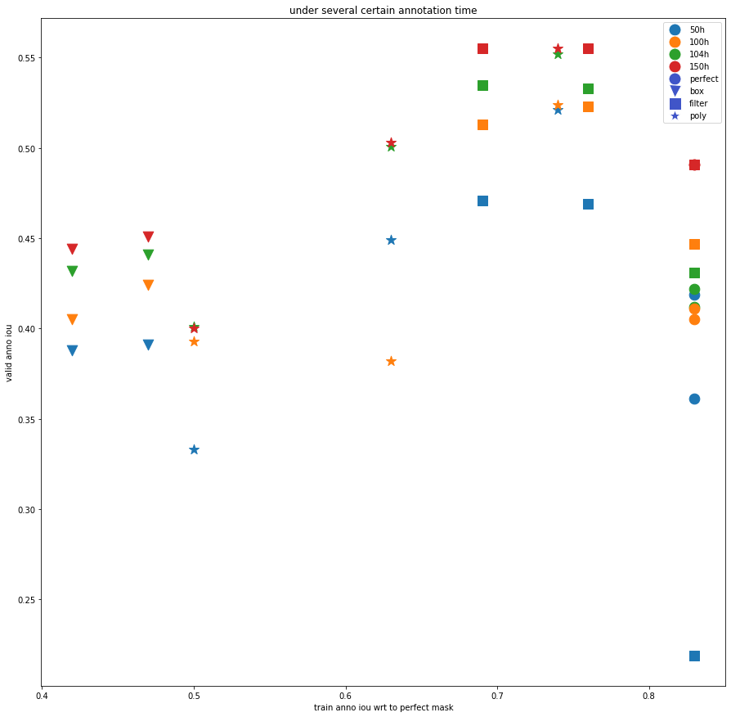
For most cases(50h, 100h, 104h), Poly-8 shows best performance under same annotation time
While for 150h, filter-9, filter-7, poly-8 shows almost same results.

Slide 18
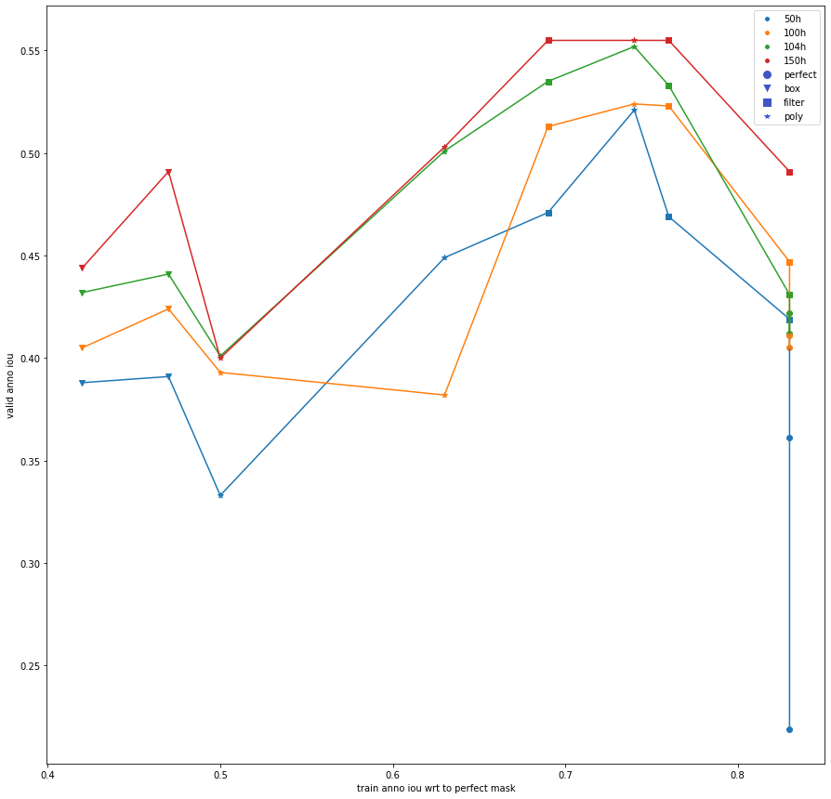
50h | 10187
iou5 | 0.449
100h | 20374
iou10 | 0.382
104h | 21279
iou104 | 0.501
150h | 30560
iou15 | 0.503
Error?

Slide 19
Main problem: only do one time
Train with same 20k data: valid iou 0.382 0.408 0.393
Train with same 10k data: 0.344 0.356 0.355
Train with different 20k data: 0.399 0.394 0.423, 0.372
Train with different 10k data: 0.345 0.339 0.352, 0.333
(data above trained for 50 epochs while others for 150 epochs)
Need update annotation time data, and then do multiple time and take average
50h | 10187
iou5 | 0.449
100h | 20374
iou10 | 0.382
104h | 21279
iou104 | 0.501
150h | 30560
iou15 | 0.503

Slide 20
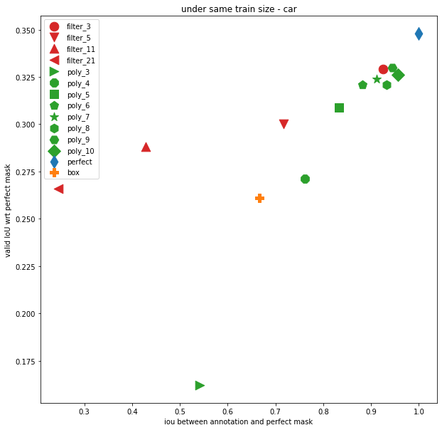
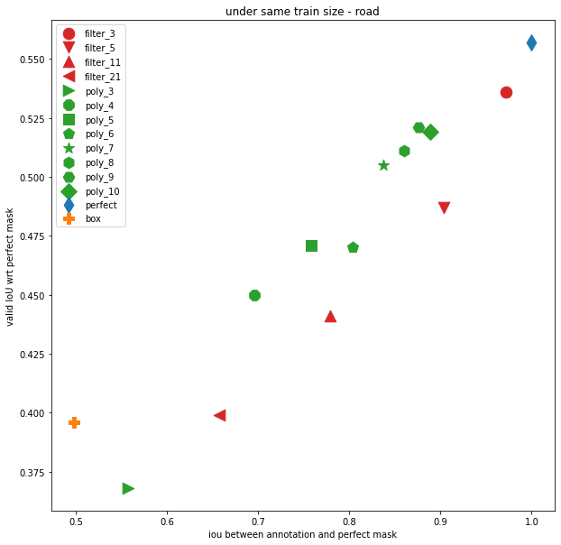

Slide 21
road | perfect | perfect2 | individual_bounding_box | multiple_bounding_box | approx_contour | less_precise_contour | triangle | pentagon | 8_to_12_edges2
IoU | 0.83 | 0.83 | 0.47 | 0.42 | 0.76 | 0.69 | 0.5 | 0.63 | 0.74
generated | Filter_7 | perfect | #4 | #5 | Filter_11 | Filter_21 | Poly_3 | Poly_5 | Poly_8
Ave_time | 816.93 | 816.93 | 115.53 | 116.97 | 314.03 | 192.57 | 148.93 | 176.7 | 235.53
50h | 2203 | 2203 | 15580 | 15389 | 5732 | 9347 | 12086 | 10187 | 7642
iou5 | 0.201 |  | 0.355 |  | 0.388 | 0.395 |  |  | 0.448

Slide 22
